Slide 1



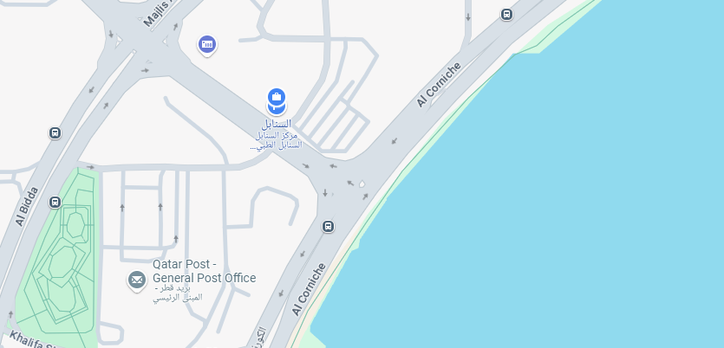
.
SPECIAL DISCOUNTED RATES FOR
University Of Doha for Science and Technology
“Your mental health journey may be a lifelong process, but it’s worth it.
A small step can lead to big progress in mental health”
Contact Us:
+974 – 700 83 700 / +974 – 4441 0667
Info@Alsanabelcenter.qa

Slide 2
Psychiatric Discounts:
Service | Before Discount | After Discount
first visit/consultation with doctor | 1000 QR | 550 QR
Follow up session with doctor (60 minutes) | 1000 QR | 550 QR
follow up session with doctor (30 minutes) | 500 QR | 350 QR
Psychotherapy session for adults (60 minutes) | 500 QR | 400 QR
Psychotherapy session for children | 1000 QR | 350 QR
Behavioral psychotherapy session for children (60 minutes) | 500 QR | 350 QR
speech difficulties & pronunciation session | 300 QR | 250 QR
TMS session | 2000 QR per session | 500 QR
ECG | 250 QR | 100 QR
memory assessment | 500 QR | 250 QR
Personality assessment - (MMPI) | 1000 QR | 850 QR
illustrated IQ assessment (90 minutes) | 1000 QR | 850 QR
illustrated IQ assessment for children (3 hours) | 2000 QR | 1600 QR
Dental Discounts:
Service | Before Discount | After Discount
Consultation & X-Ray | 100 QR | 50 QR
Scaling and Polishing | 480 QR | 250 QR
Dental filling (Depends on the size | 400 to 650 | 300 QR
Teeth Whitening | 1600 to 2000 | 900 QR
Dental Crown | 1800 to 3000 | 1200 QR
Dental implant | 6000 QR | 4500 QR
Hollywood smile | 2450 QR | 1000 QR
Discount Rate of 20% on all other dental services (around 300 services)

Slide 3
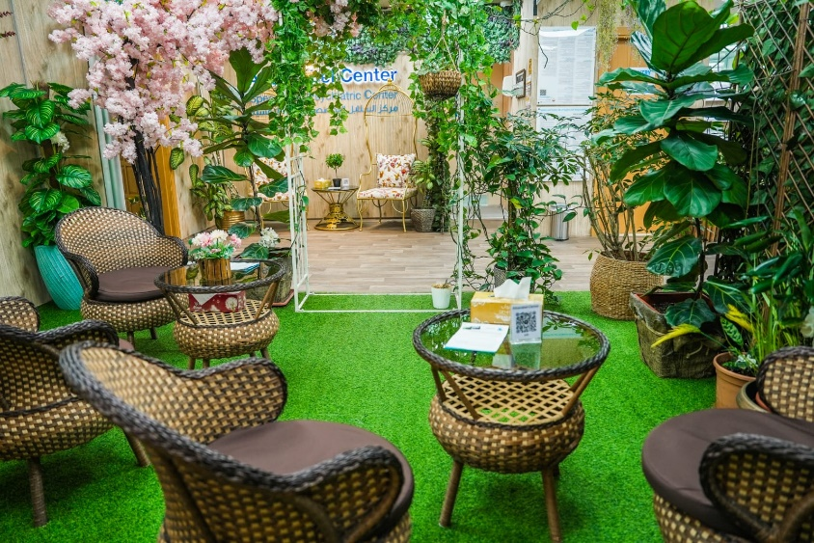
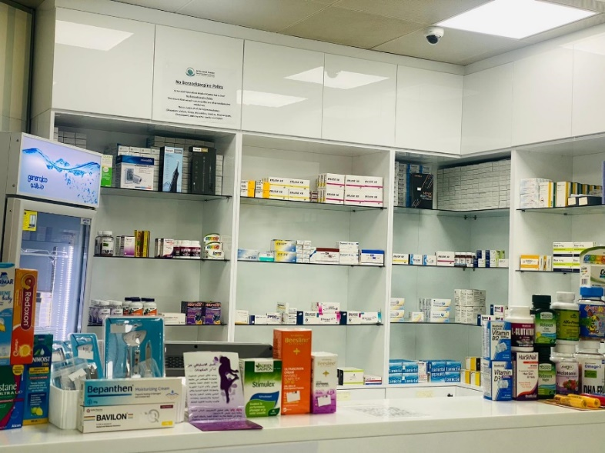
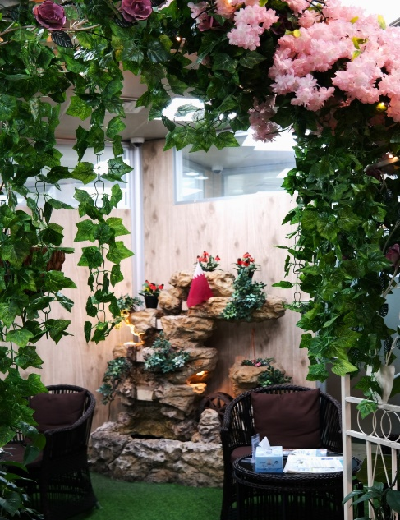
Al-Sanabel psychiatric center aims to provide specialized and comprehensive psychiatric care to its patients. Their vision includes offering a comfortable, reliable, private and confidential environment for individuals seeking mental health services.
Terms & Condition
Rates are valid until the end of January 2026
This special offer is strictly subject to availability

